Slide 1
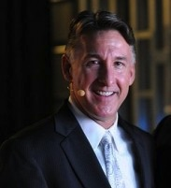
當責團隊 Accountability Group
Jim Winkler
產品銷售副總裁 Vice President of Sales
本簡報中提到的收入等級純屬舉例說明，無意代表美安香港經銷商的一般收入，也無意表示任何經銷商皆可賺取同等收入。美安香港經銷商的成功與否，取決於其在發展事業時的努力、才能與投入程度。The income levels mentioned in the following presentation are for illustration purposes only. They are not intended to represent the income of a typical Market Hong Kong Distributor, nor are they intended to represent that any given Independent Distributor will earn income in that amount. The success of any Market Hong Kong Independent Distributor will depend upon the amount of hard work, talent, and dedication which he or she devotes to building his or her Market Hong Kong Business.

Slide 2
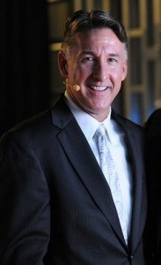
Jim Winkler
美安集團產品銷售副總裁
1997年開始兼職經營超連鎖™事業
執行副總裁級 四個佣金週期共賺取HK$345,000
賺取數百萬美元收入
丈夫及父親
Vice President of Sales, Market America Inc.
Opened UnFranchise™ Part Time in 1997
Executive Field Vice President
HK$345,000 in 4 Commission weeks
Multi-Million Dollar Earner
Husband and Father
本簡報中提到的收入等級純屬舉例說明，無意代表美安香港經銷商的一般收入，也無意表示任何經銷商皆可賺取同等收入。美安香港經銷商的成功與否，取決於其在發展事業時的努力、才能與投入程度。The income levels mentioned in the following presentation are for illustration purposes only. They are not intended to represent the income of a typical Market Hong Kong Distributor, nor are they intended to represent that any given Independent Distributor will earn income in that amount. The success of any Market Hong Kong Independent Distributor will depend upon the amount of hard work, talent, and dedication which he or she devotes to building his or her Market Hong Kong Business.

Slide 4
社交媒體
Social Media
Twitter - jfwinkler
Facebook – facebook.com/jwinkler.ma
Instagram – jfwinkler
www.winklersworld.com

Slide 5
產生效益的活動
銷售產品
宣傳事業
賣票
Result Producing Activities
Sell the Products
Sell the Business
Sell Tickets

Slide 6
如何做到?
銷售產品
How? Sell the Products

Slide 7
銷售產品
自己先購買產品
創造你個人的購物年金
網上購物 – HK.SHOP.COM
產品網路研討會
產品訓練
試用產品
產品專頁電郵
第三方 – 產品見證
Sell the Products
Buy products yourself first
Create your own Shopping Annuity
Online Shopping – HK.SHOP.COM
Product Webinars
Product Trainings
Samples
Email from Product Page
Third Party - Testimonials

Slide 8
銷售產品
家庭產品簡報會
展示計劃 – 於展示計劃後銷售產品
1 對 1 – 產品分享
本週精選
社交媒體
轉介人（給轉介人免費產品）
Sell the Products
Home Product Presentations
Showing the plan – product sale at end of the plan
1 on 1 – sharing products
Special of the Week
Social Media
Referrals (free product for referrals)

Slide 9
產生效益的活動
銷售產品
宣傳事業
賣票
採取大量行動﹗
Result Producing Activities
Sell the Products
Sell the Business
Sell Tickets
Take Massive Action!

Slide 10
如何做到?
宣傳事業
How? Sell the Business

Slide 11
切合實際的目標
每星期跟四位朋友對話
每星期跟一位朋友展示計劃
每星期增加10個新名單(每日兩個，一星期做5日)
Realistic Goals
Talk to four people a week
Show the plan to one person a week
Add 10 new possibilities to your names list each week (two a day – 5 days a week)

Slide 12
為甚麼我們要做招募？
新的事業夥伴
擴展業務
賺取佣金
證實這生意的可行性
Why do we need to recruit?
New Business Owner
Activate
Earn Commissions
Prove the business works

Slide 13
為甚麼我們要做招募？
培養更多超連鎖™店主
延續士氣
把業績點數放置最底層
安全感
證實我們是 “獨立經銷商”
Why do we need to recruit?
Growing UnFranchise™ Owner
Continue Momentum
Place BV to lowest spot
Security
Prove that we are not “Dependent Distributors”

Slide 14
為甚麼我們要做招募？
資深超連鎖™店主
成為領袖，而不是經理
站在最前，帶領團隊！
你做甚麼，你的團隊就做甚麼！
增加你的佣金收入！
Why do we need to recruit?
Veteran UnFranchise™ Owner
Be a leader not a manager
Lead from the front!
Your team will do what you do!
Increase your income!

Slide 15
展示計劃的方法
展示圖冊 (產品代號：HK700)
Ipad
手提電腦
紙和筆
23分鐘UBP短片(youtube)
網上研討會 (www.jwlive.info)
Ways of Showing the Plan
Flipchart (Product code: HK700)
Ipad
Laptop
Paper and pen
23 minute video (youtube)
Webinar (www.jwlive.info)

Slide 16
產生效益的活動
銷售產品
宣傳事業
賣票
採取大量行動﹗
Result Producing Activities
Sell the Products
Sell the Business
Sell Tickets
Take Massive Action!

Slide 17
如何做到?
賣票（教育）
How? Sell Tickets (Education)

Slide 18
賣票（教育）
展示計劃後 （跟進）
超連鎖™事業簡報會後
新事業夥伴（登記加入）
電話工作坊
定時打電話跟進和等候
社交媒體
要有急切性
跟隨起步指南的行動
Sell Tickets (Education)
After Showing the plan (Follow Up)
After the UBP
New Business Owners (Enrollment)
During Call Workshops
Call stable and waiting
Social Media
Sense of Urgency
Attach to Getting Started Guide

Slide 19
當責 Accountability
專注和有組織的
Focus and
Structure
競爭
Competition
團隊精神
Teamwork
產生效益的活動
Result Producing
Events

Slide 20
怎樣開始？
跟很多人非常努力地工作
需要一個很有組織和當責的團隊
想創造一個如何快速躍升為成功者的訓練方法!
想打造一個團體的感覺 - (精英團隊的一部分)
需要發展領袖和賺錢的人
How Did It Start?
Working too hard with too many people
Need for structure and accountability
Wanted a way to train rising stars fast!
Wanted to create a feeling of community - (Part of Elite Team)
Needed to develop leaders and money earners

Slide 21
Work in Progress
仍在打拼的團隊
2009年5月 – Fantastic Four (4個人)
2010年5月 – Terrific Ten (10個人)
2011年4月 – Elite Eleven (11個人)
2011年10月至現在 – Team Twenty (20個人)
2013年6月 – UK Accountability Group (英國當責團隊)
May 2009 – Fantastic Four
May 2010 – Terrific Ten
April 2011 – Elite Eleven
October 2011 to Now – Team Twenty
June 2013 – UK Accountability Group

Slide 22
Accountability Tools
當責的工具
每週電話會議
- 星期初舉行
- 保持士氣是很重要
- 30-45分鐘
- 最好成績的10位夥伴對上星期報告做檢閱
- 主持一定要提出問題
- 最好成績的10位夥伴對下星期報告做預覽
- 需討論獎勵積分之事宜
Weekly Conference Call
- Early in the week
- Very important for momentum
- 30 to 45 minutes long
- Top Ten people review last week
- Moderator must ask questions
- Top Ten people preview the next week
- Bonus points are discussed

Slide 23
Accountability Tools
當責的工具
記錄當責的表格
- 產生效益的活動
- 跟每個新加入的組別更新資訊
- 提供即時的回應
- 加強積極正面的行為
- 下載表格：www.manorthern.com
Accountability Form
- Result Producing Activities
- Updated with each new group
- Gives immediate feedback
- Reinforces positive behavior
- Download – www.manorthern.com

Slide 24
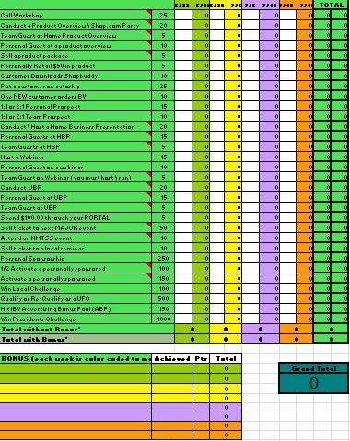
下載表格連結：www.manorthern.com

Slide 25
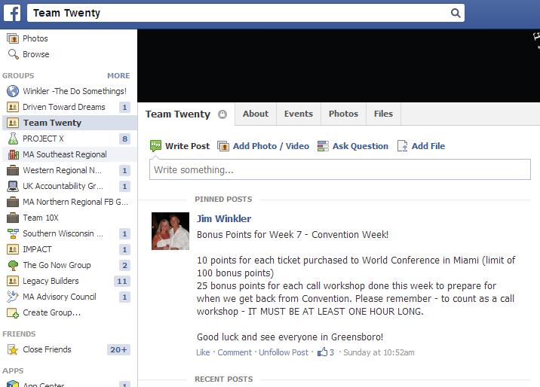

Slide 26
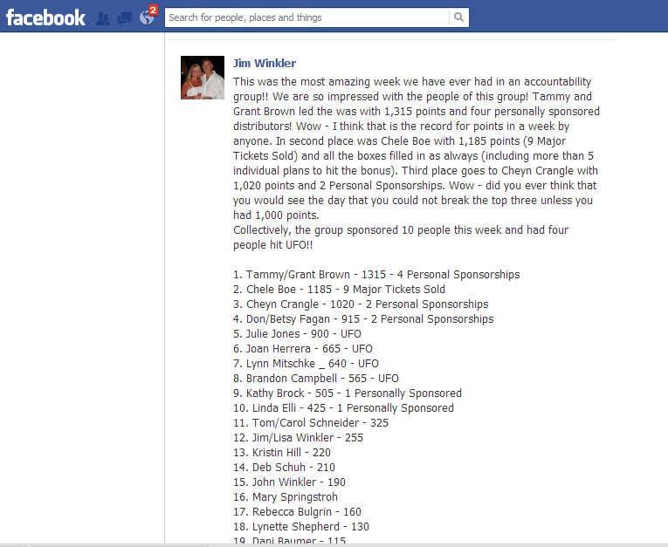

Slide 27
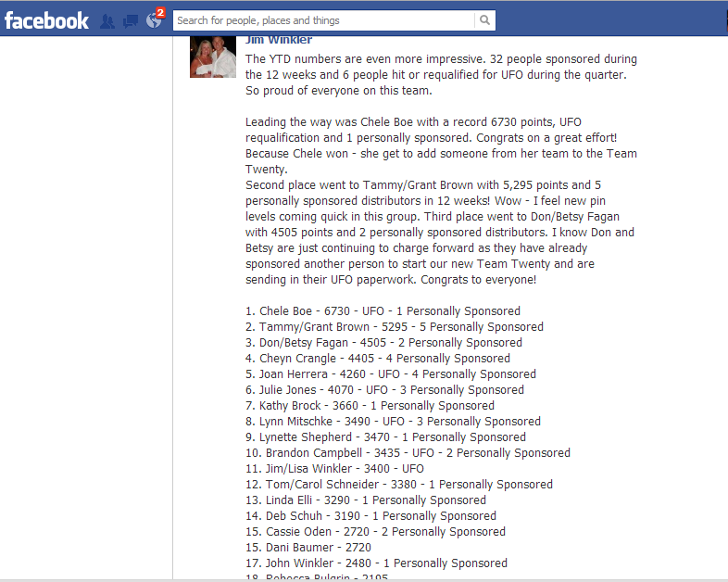

Slide 28
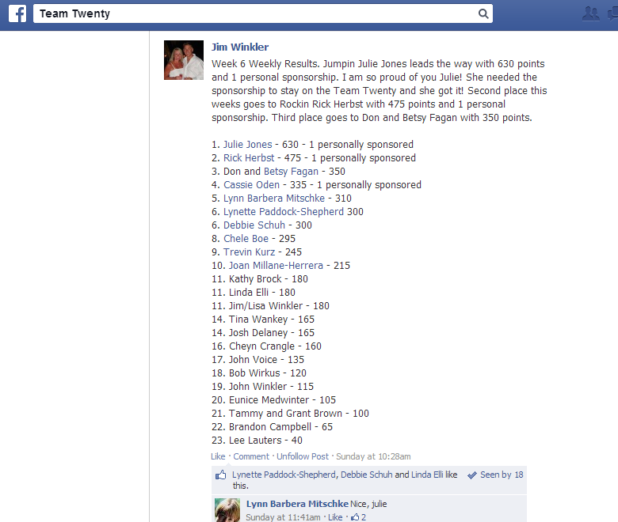

Slide 29
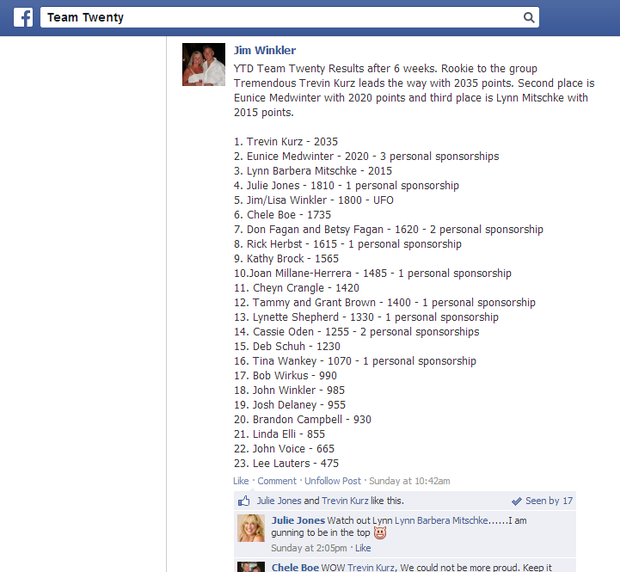

Slide 30
Bottom Line
底線
把那些想做的人和真正行動的人分隔
不准隱瞞或投訴
每一個夥伴都需要負起某些責任
數字從不騙人
Separates those who say want to do it from those who really do it
No hiding or complaining
All of us need some accountability
THE NUMBERS DON’T LIE

Slide 31
當責 Accountability
專注和有組織的
Focus and
Structure
競爭
Competition
團隊精神
Teamwork
產生效益的活動
Result Producing
Events

Slide 32
嶄新的公司，嶄新的機會，嶄新的你
2014美安香港年會
mhk Annual Convention
#MHKAC2014

